Slide 1
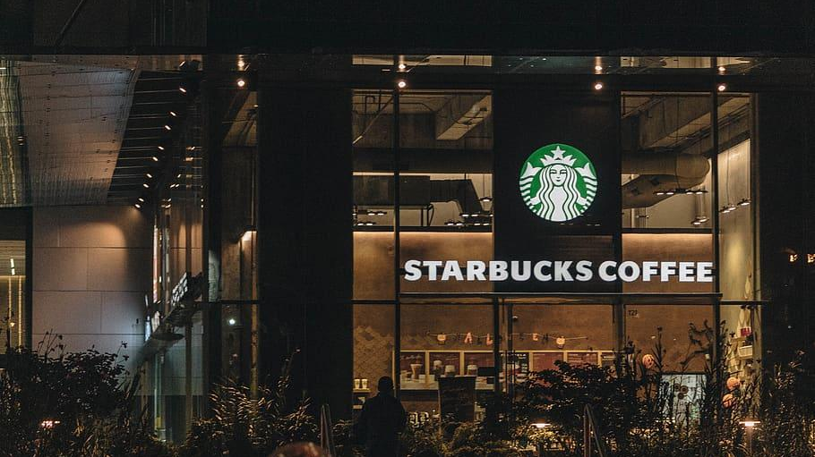
Starbucks Locations Worldwide
2021 version
Group Members:
Chung-Kuang Lin, Candice Chen, Melody Lin, Jeffrey Wang, Phoebe Ling
FA2021 IS 537 Final Project
Group Members:
Chung-Kuang Lin
Candice Chen
Melody Lin
Jeffery Wang

Slide 2
Introduction to Dataset

Slide 3
Starbucks Locations Worldwide 2021.ver
Name, ownership type, and location of every Starbucks store in operation
17 columns, 28289 rows
Source: Kaggle
This data was scraped from the Starbucks store locator webpage
Notes:
The dataset we choose is the starbucks location worldwide 2021 on kaggle.com
The dataset contains basic information about the name of the branch, ownership type, address and timezone informations in a total of 17 columns
Originally obtained by scraping from Starbucks locator website.

Slide 4
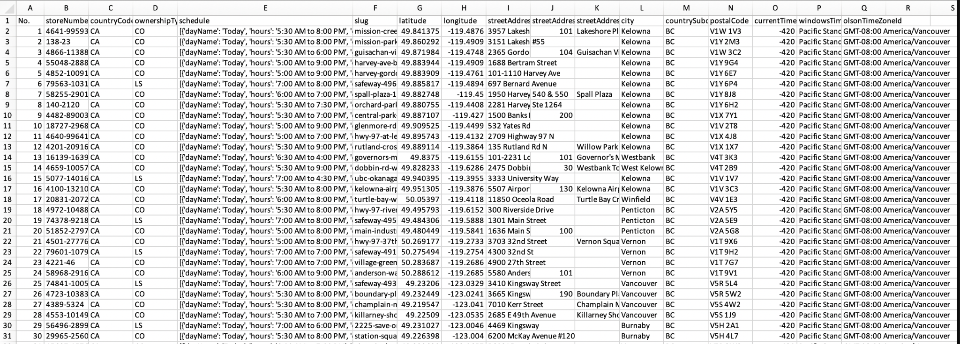
Introduction to Dataset
Notes:
Here is a screenshot of the partial raw dataset, most of the time will be explaining how we clean up the
“Schedule” column at column E on the spreadsheet.

Slide 5
Questions & Cleaning Plan

Slide 6
Questions
What is the average opening hours in major cities?
Would different ownership types influence opening hours ?
What is the closed days for branches in the same time zone?
Notes:
We come up with 3 questions in which the starbucks locations dataset can answer.
Avg opening hours
Ownership types affect opening hours
* Will closed day different from timezones? (Sounds counterintuitive, but I’ll explain this in the visualization part)

Slide 7
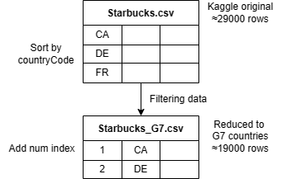
Pre-processing Dataset
Sorted rows by country names.
Choose The Group of Seven (G7) countries as our analysis subjects separation
Adding index for later partitioning
Notes:
First

Slide 8
Chosen part - G7 countries
Name & Countrycode | rows
United States (US) | 15003
Japan (JP) | 1665
Canada (CA) | 1219
Britain (GB) | 975
France (FR) | 94
Germany (DE) | 29
Grand Total | 18985
Notes:
We reduced the original datasets from 29 thousands into 19 thousands rows by
Only selecting the G7 countries to keep the scale of the data set manageable. Since some of us are cleaning with pandas.
One noticeable thing is Italy is missing since the raw dataset did not include any branches from Italy.
Probably dominating franchise might be illy.

Slide 9
Data Cleaning - Columns
[Number] “Column names” | Issues
[1] No. [2] storeNumber [3] countryCode [4] ownershipTypeCode [5] schedule [6] slug [7] latitude [8] longitude [9] streetAddressLine1 [10] streetAddressLine2 [11] streetAddressLine3 [12] city [13] countrySubdivisionCode [14] postalCode [15] currentTimeOffset [16] windowsTimeZoneId [17] olsonTimeZoneId | Typically all uppercase, but get a lowercase Definitely need normalization to have the list of values separated Redundant information overlapped with streetAddress Not separated by any rules Not separated by any rules Not separated by any rules All lowercase expected Convert into the format that fits the country’s postal system Delete Separate into GMT and GMT_region
Notes:
Let’s take a look a t what issue each column have
Countrycode usually displayed in uppercase, but we get lowercase instead
Schedule need serious normalization since it’s a huge piece of strings
Slug seems to have the same info as the streetaddress
The 3 streetaddress columns are not separated by any rules so joining them is much better
City is titlecased but we wish to have it all lowercase
Countrysubdivisioncode should follow the proper format of their postal system
Last, we need the olsonTimeZoneId to be 2 independent columns

Slide 10
Data Cleaning
&
Tool Analysis

Slide 11
Data Cleaning tasks
[Number] “Column names” | Cleaning plans
[3] countryCode [5] schedule [9] streetAddressLine1 [10] streetAddressLine2 [11] streetAddressLine3 [12] city [13] countrySubdivisionCode [17] olsonTimeZoneId | All uppercase Move to the end and separated into open and closed hours/per day. Expecting 14 columns in total. Merge all 3 streetAddress columns with | All lowercase All uppercase Split into GMT and GMT_region column * Null as designated null value
Notes:
1. countryCode to all uppercase
2. Split the schedule column into 7 days then fill in opening and closed hours as values.
3. Merge three columns regarding address.
4. City all lowercase while countrySubdivisionCode should be all uppercase.
5. Split the olsonTimeZoneId column into GMT and its region.
Fill Null in empty cell.

Slide 12
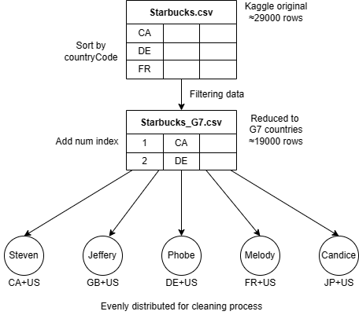
Processing Steps
Each member process a country and some rows of US
Choice our preferable tools:
Python: pandas, json, datetime
OpenRefine
MS Excel
Discuss the results and comparison of different approaches
Notes:
Our approach to clean the data is to split it into 5 parts.
Having each group member handle one country plus some rows from US. and then we aggregate the finished part into a complete data set

Slide 13
Data cleaning process - Schedule Column
Original format:
Huge list with all the operating hours in one column
Some days are not present as the name of week days
Target format
Separate into open and close hour for each day
Change the time format into 24-hour clock
Notes:
The original schedule is a list contains 7 dictionaries inside.
Another issue is that the week day is not written properly like “Today”, “Tommorrow”
Our target format will be the example at the bottom, with separated opening and closing hour in 24 hr format for each day in a week

Slide 14
Data cleaning process - Schedule Column
 | Major Tools
Cleaning Steps | OpenRefine & Excel | Python (Json) | Python | Python & Excel
Split column to days | Split with special characters | Split with special characters | Split with special characters | Excel: text to columns
Convert data format |  | Json package
Get operating hours | Split with special characters | Key: hours By rows | Extract with regex By columns | Split with special characters
Split open and close |  | Split with special characters
Convert time format | Excel: format cells | datetime package: to_datetime function
Repetitive tasks | Manual | Self-defined function loops
Notes:
OpenRefine & Excel is rather simple, just split the column until we reach the target stings
While python we have more varieties doing this, after we removed the special characters
Read with json pacjage
Extract target string with Regex
Split the column by loops until we have the proper informations

Slide 15
Data cleaning process - Others
Used built-in functions from each tools
 | Major Tools
Cleaning Steps | OpenRefine | Python
Convert city into lowercase | value.toLowercase() | .str.lower()
Convert countrySubdivisionCode into upper case | value.toUppercase() | .str.upper()
Split olsonTimeZoneId into GMT and region | core/column-split | .str.split()
Merge three address columns | core/column-addition | Merge by rows: can avoid nan Merge by columns: need extra step to replace nan

Slide 16
Tools Comparison
Tools | OpenRefine | Python | Excel
Pros | User friendly interface Finding exception strings: cluster function Rollback to previous step | Read the nested strings: JSON package Easy to save intermediate results Deal with larger dataset Convenience for repetitive tasks | User friendly interface Most flexible Clear overall view
Cons | Bad in repetitive tasks Strict data format requirement for some functions | Hard to design when there are lots of exception Need in-depth understanding and have low tolerance to data format | Bad in repetitive tasks Cannot deal with large dataset Inconvenience in keeping the cleaning track
Notes:
Remove square bracket and read as json-like format

Slide 17
Post-cleaning validations
Schedule with all null value
A great portion opening hours info in Japan are Null
City with similar name but different format
Highlight with OpenRefine or Excel and adjust manually
Other validation check:
Check the length of postal code
Check the value range of latitude and longitude

Slide 18
Visualization
Excel & Tableau

Slide 19
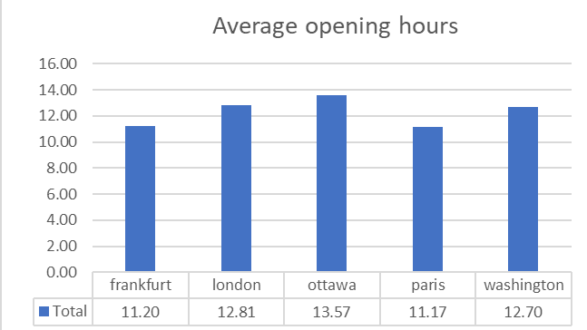
What is the average opening hours in major cities?
Choose one city in every country. The data in Japan is null, so it’s excluded.
Notes:
washington DC, Paris, Ottawa, osaka, frankfurt, London

Slide 20
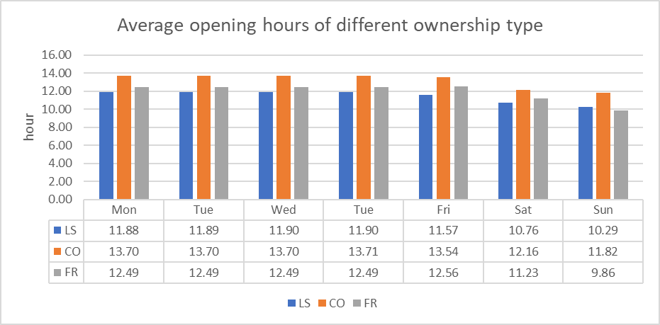
Would different ownership types influence opening hours ?
Notes:
1st Co: Company-operated
2nd Fr: Franchise
Ls: Licensed stores

Slide 21
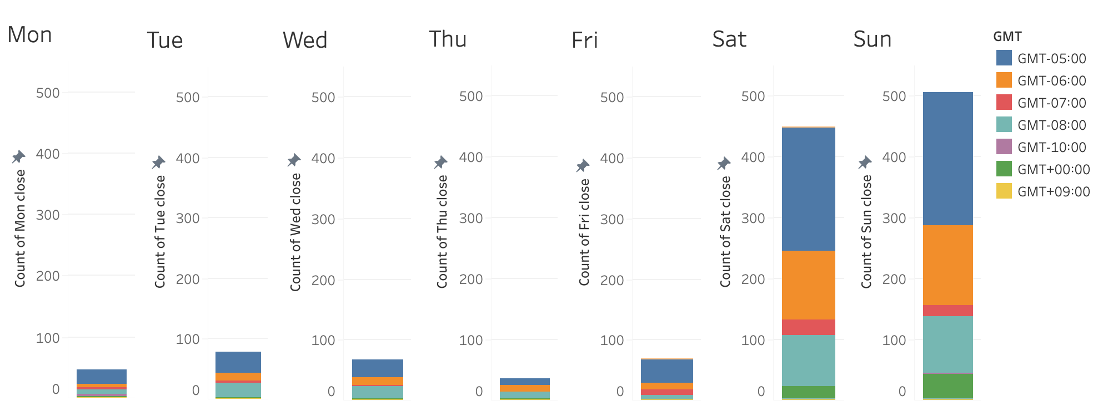
What is the closed days for branches in the same time zone?
Notes:
Some coffee shops in TW will have the opening strategy to close on Mon and open at weekends.
Closing date will
JP was not included for exceeding numbers of nulls

Slide 22
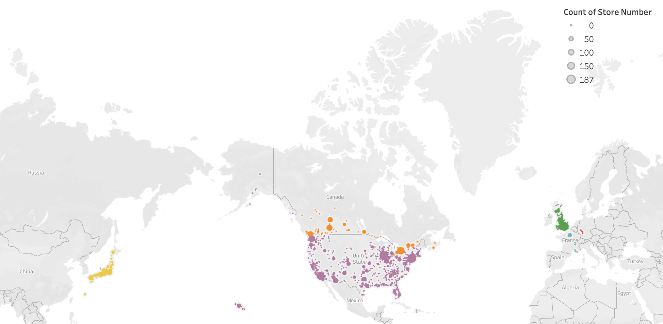
Map visualization

Slide 23
THANK YOU

